Slide 1

Genetics of Epidermolysis Bullosa
Dr Russell Gear
russell.gear@ccdhb.org.nz
June 2026

Slide 2
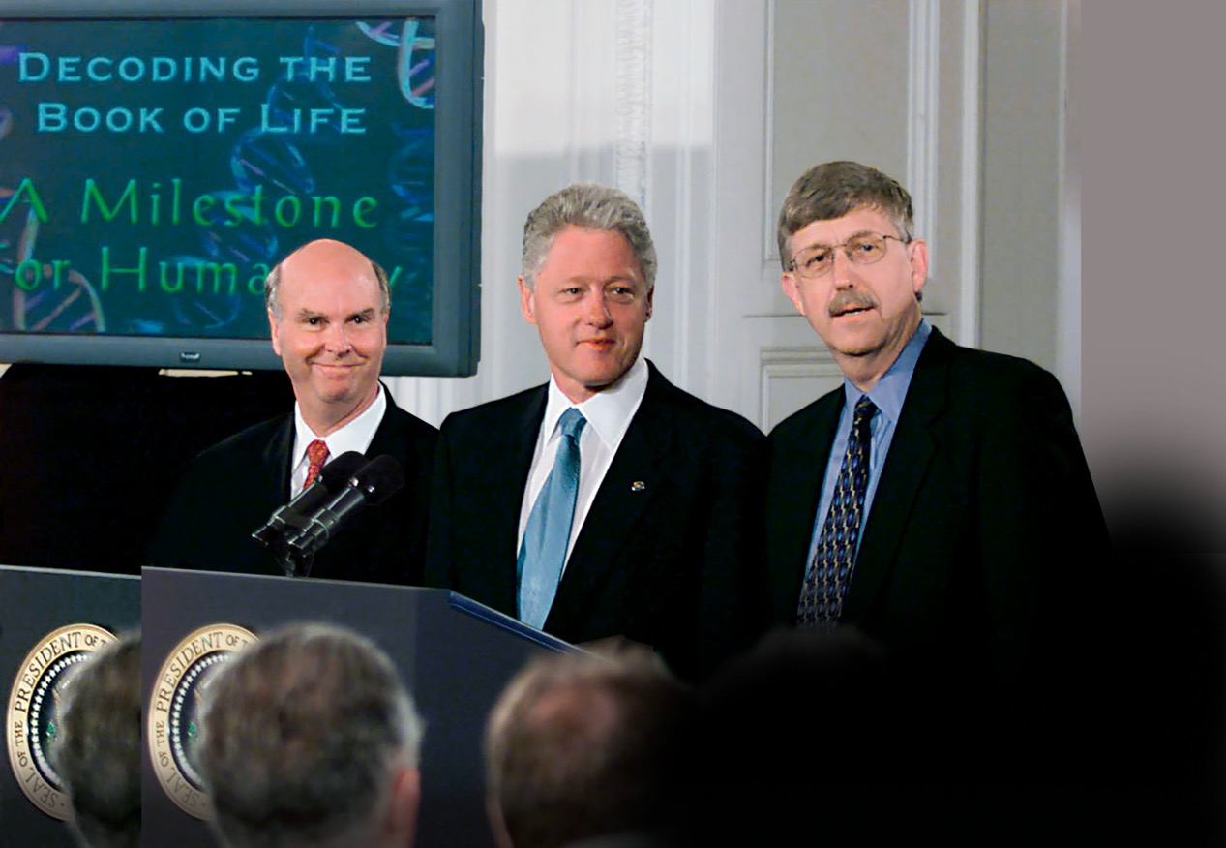
“We have caught the first glimpse of our own instruction book, it will revolutionise the diagnosis, prevention, and treatment of most, if not all, human diseases.”
Bill Clinton, 2000

Slide 3
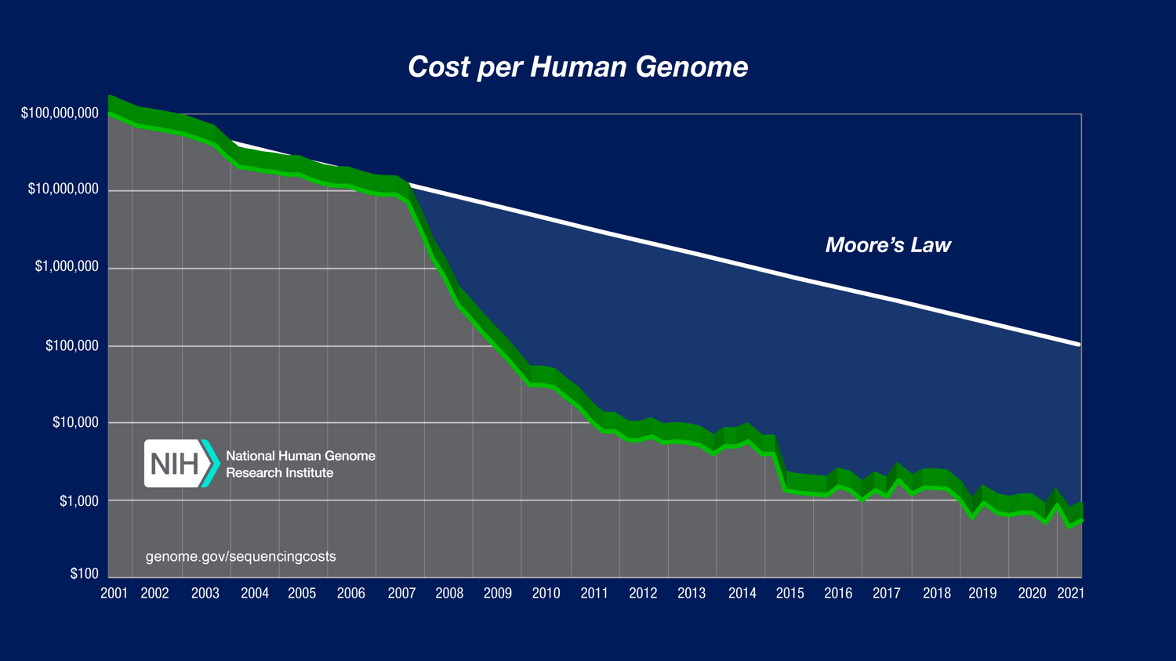
Notes:
Cost of sequencing graph

Slide 4
Benefits (and Risks)
of Genetic Testing
Diagnosis
Family
Therapy
Natural History
Finances
Uncertainty
Incidental findings
Biological Relationships
Insurance
Prognosis

Slide 5
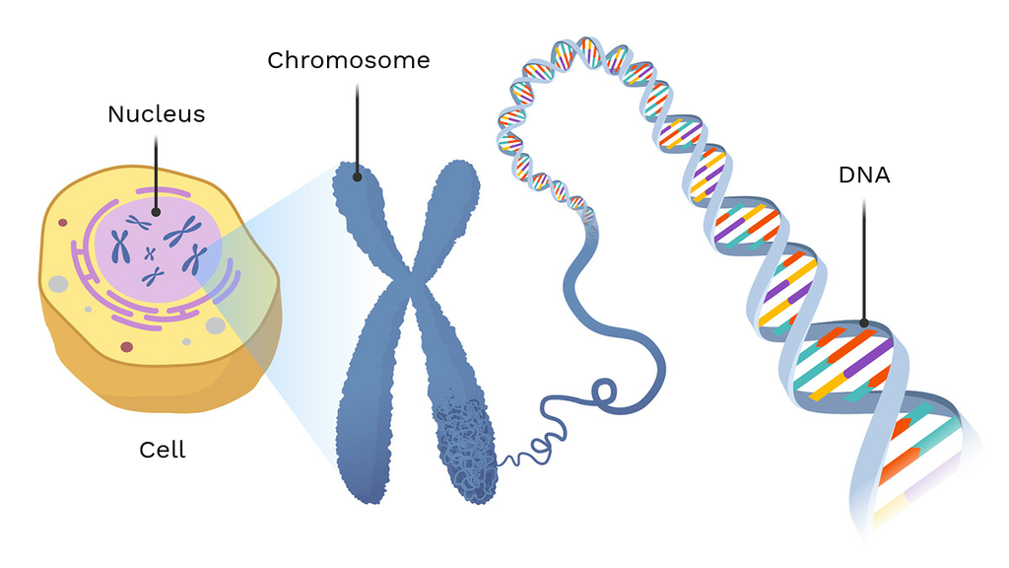
A <-> T
C <-> G
Notes:
A, C, T, G

Slide 6
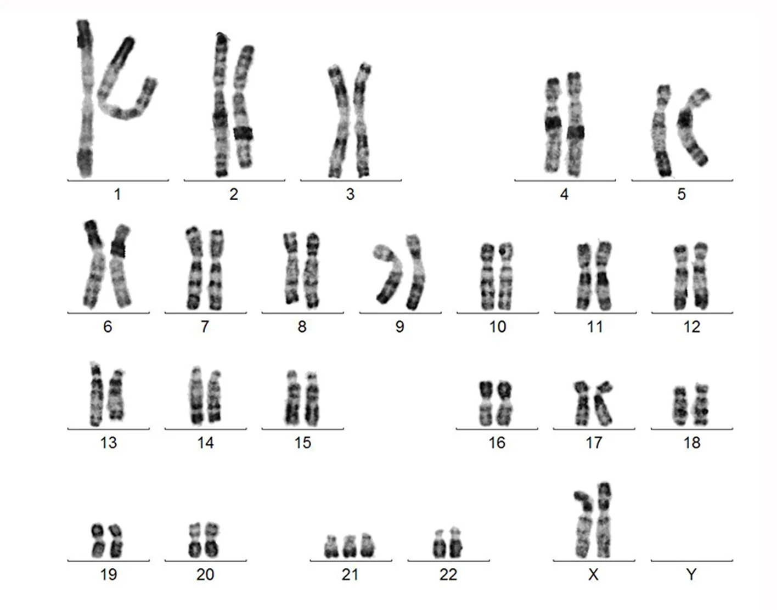
Notes:
Karyotype

Slide 7
A <-> T
C <-> G
Notes:
A, C, T, G

Slide 8
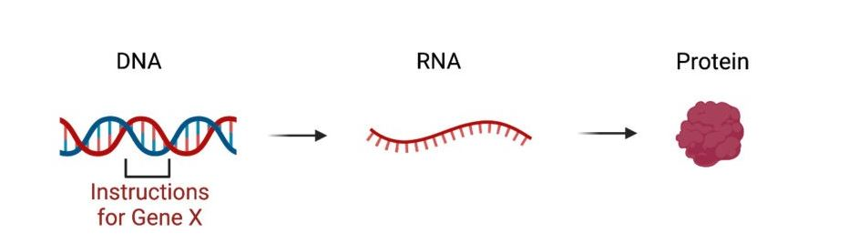
Notes:
DNA-RNA-Protein

Slide 9
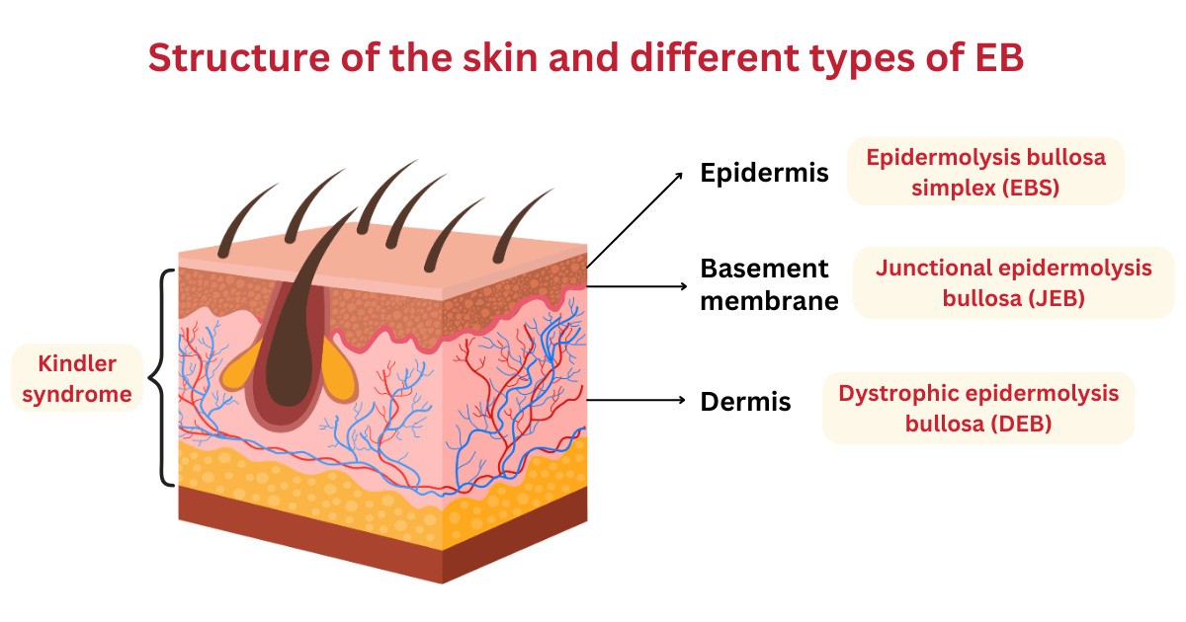
Notes:
DNA-RNA-Protein

Slide 10
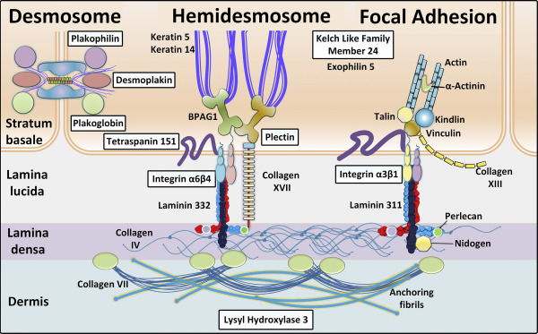
Notes:
DNA-RNA-Protein

Slide 11
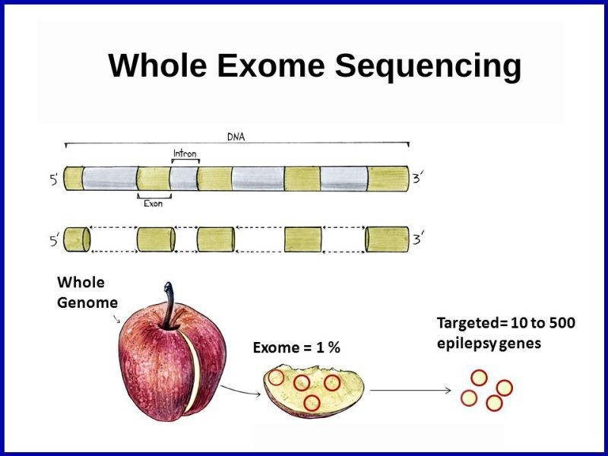

Slide 12
Accurate, Fast, Cheap

Slide 13
Benefits (and Risks)
of Genetic Testing
Diagnosis
Family
Therapy
Natural History
Finances
Uncertainty
Incidental findings
Biological Relationships
Insurance
Prognosis

Slide 14
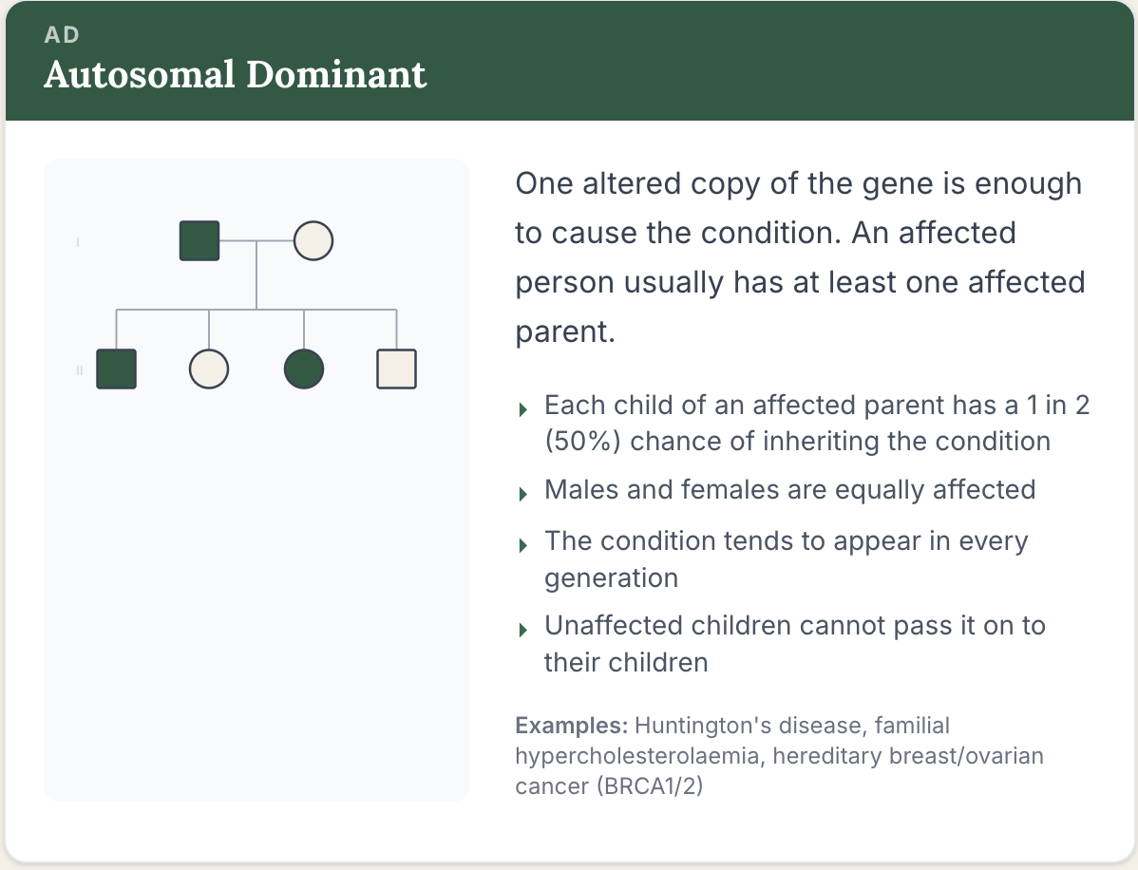

Slide 15
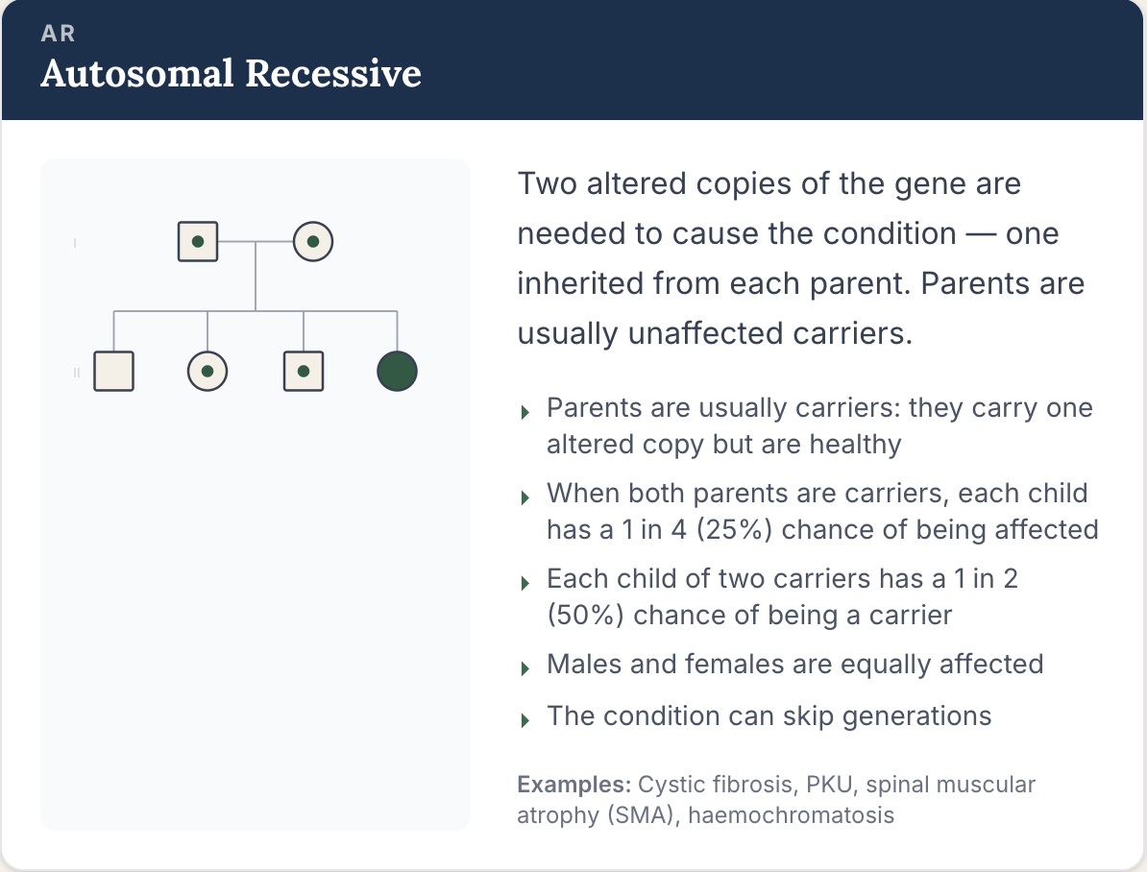

Slide 16
